Slide 1

Mary, Queen of the Family Parish
is a welcoming, diverse, multicultural, Catholic community.
We seek to live, teach and share the joy of the Gospel;
to grow as disciples of Jesus through prayer, witness and action
and to respond to the needs of the family in the Blacktown community and beyond.
Notes:
Saturday 5.30PM First Sunday of Advent
16th Sunday in Ord Time Year B

Slide 2

Welcome to our Parish …
Second Sunday of Advent
You have entered a SACRED SPACE ... A SACRED TIME…
Please ensure all mobile phones are switched off.
Please be respectfully quiet as we prepare for our Celebration.
Notes:
Saturday 5.30PM First Sunday of Advent
16th Sunday in Ord Time Year B

Slide 3
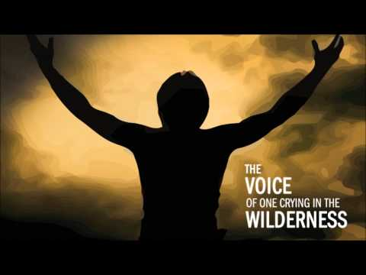
A voice cries in the wilderness:
Prepare a way for the Lord,
make his paths straight.
Notes:
16th Sunday in Ord Time Year B

Slide 4
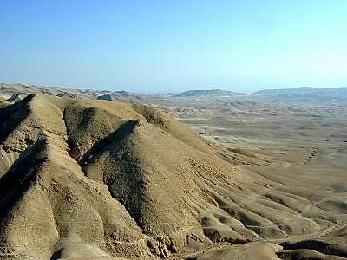
Every valley will be filled in,
every mountain and hill be laid low,
winding ways will be straightened
and rough roads made smooth.
Notes:
16th Sunday in Ord Time Year B

Slide 5
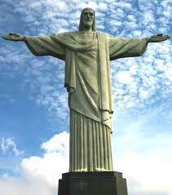
And all mankind shall see the salvation
of God.
Notes:
16th Sunday in Ord Time Year B

Slide 6
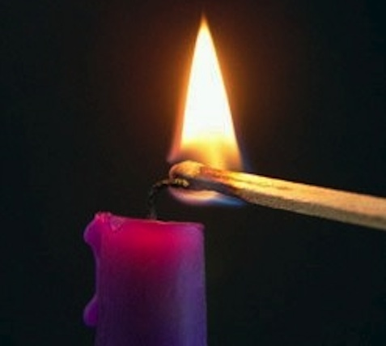
How will I prepare a way for the Lord
this Advent?

Slide 7
PLEASE STAND

Slide 9
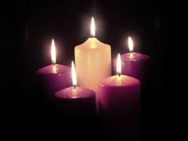
Lord our God,
we praise you for your Son, Jesus Christ:
he is Emmanuel, the hope of the peoples,
he is the wisdom that teaches and guides us, he is the Savior of every nation.
Lord God, let your blessing come upon us
as we light the candles of this wreath.
May the wreath and its light be a sign
of Christ's promise to bring us salvation.
May he come quickly and not delay.
We ask this through Christ our Lord.

Slide 11

Responsorial Psalm
The Lord has done great things for us; we are filled with joy.

Slide 12


Slide 13
Gospel Acclamation
Alleluia, alleluia!
Prepare the way of the Lord, make straight his paths:
all people shall see the salvation of God.
Alleluia!

Slide 15
APOSTLES’ CREED
I believe in God,
the Father almighty,
Creator of heaven and earth,
and in Jesus Christ, his only Son, our Lord,
(At the words that follow, up to and including the Virgin Mary, all bow.)
who was conceived by the Holy Spirit,
born of the Virgin Mary,
suffered under Pontius Pilate,
was crucified, died and was buried;
he descended into hell;

Slide 16
on the third day he rose again from the dead;
he ascended into heaven,
and is seated at the right hand
of God the Father almighty;
from there he will come to judge
the living and the dead.
I believe in the Holy Spirit,
the holy catholic Church,
the communion of saints,
the forgiveness of sins,
the resurrection of the body,
and life everlasting. Amen.

Slide 18
First Collection
This collection goes to the Bishop
for the support of the Diocese.
Thank you for your contribution

Slide 20
Holy, Holy, Holy
Holy, Holy, Holy Lord God of hosts,
Heaven and earth are full of your glory.
Hosanna in the highest
Blessed is he who comes
in the name of Lord,
Hosanna in the highest.
The English translation of The Roman Missal © 2010,
International Commission on English in the Liturgy Corporation. All rights reserved.

Slide 22
Save us, Saviour of the world,
for by your Cross
and Resurrection
you have set us free.
Memorial Acclamation
When we eat this Bread and drink this Cup, we proclaim your Death,
O Lord, until you come again.
We proclaim your Death, O Lord,
and profess your Resurrection
until you come again.
The English translation of The Roman Missal © 2010,
International Commission on English in the Liturgy Corporation. All rights reserved.
Notes:
Sunday 10AM First Sunday of Advent
7am - 14th Sunday in Ord Time
16th Sunday in Ord Time Year B

Slide 24
Amen
When we eat this Bread and drink this Cup, we proclaim your Death,
O Lord, until you come again.
Amen
We proclaim your Death, O Lord,
and profess your Resurrection
until you come again.
The English translation of The Roman Missal © 2010,
International Commission on English in the Liturgy Corporation. All rights reserved.
Notes:
Sunday 10AM First Sunday of Advent
7am - 14th Sunday in Ord Time
16th Sunday in Ord Time Year B

Slide 26
Lamb of God
Lamb of God, you take away the sins of the world, have mercy on us.
Lamb of God, you take away the sins of the world, have mercy on us.
Lamb of God, you take away the sins of the world, grant us peace.
The English translation of The Roman Missal © 2010,
International Commission on English in the Liturgy Corporation. All rights reserved.

Slide 28
Second Collection
What you contribute now
is for the support of our
parish and its mission.
Thank you for your generosity

Slide 29
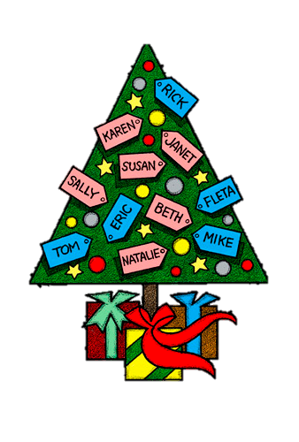
VINNIES GIVING TREE AND APPEAL
Giving Tree
Please take a tag and return items to Church by Friday 11 December.
Helpers needed to pack Hampers
Fr Sid Moseley Meeting Room @ St Michael’s
Saturday 12 December from 10.00am or
Sunday 13 December from 11.00am.
Annual Christmas Appeal
12/13 December at all Masses.
Please give generously.

Slide 30
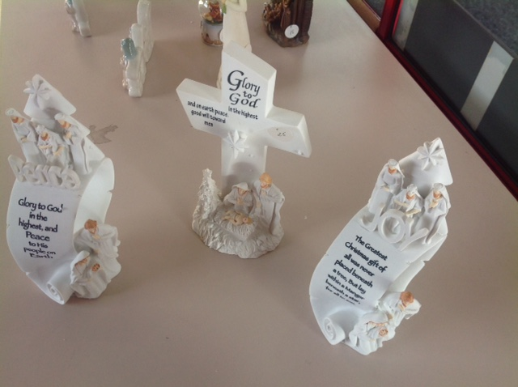
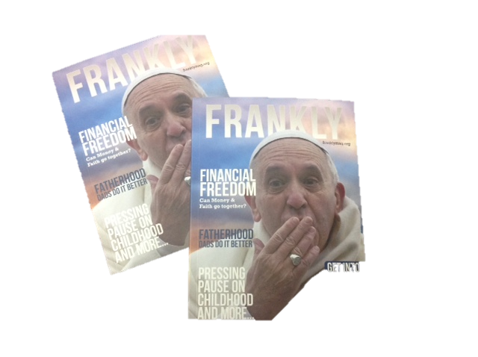
PIETY STALL
Christmas Gifts
& Nativity Scenes
Christmas Cards
(8 cards - $2)
      Frankly
    Now Available!
Notes:
16th Sunday in Ord Time Year B

Slide 31
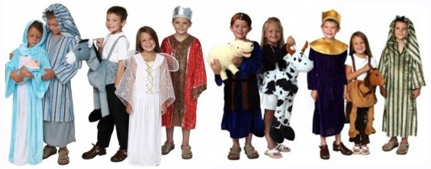
Children’s Mass – Christmas Eve
Come dressed as an
angel or shepherd!

Slide 32
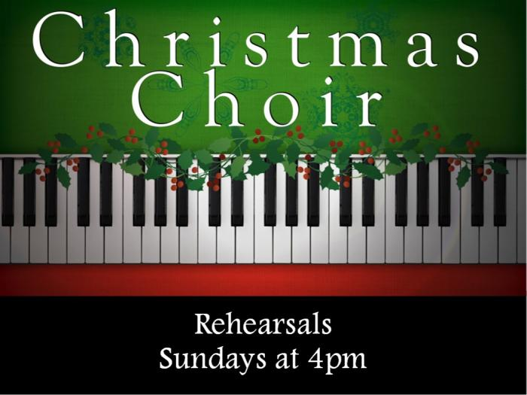
Christmas Choir – Midnight Mass
@ St Patrick’s
Practice 6.30pm Saturday
Notes:
16th Sunday in Ord Time Year B

Slide 33
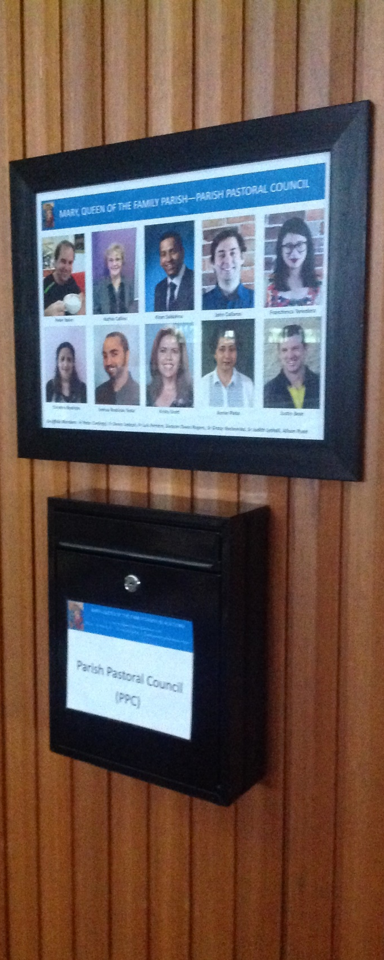
PPC MINISTRY SURVEY
If you are in a Ministry and are willing to complete a survey please leave your name and number at the Parish Office,
or place your details in the PPC Letterbox in either Church.
Notes:
16th Sunday in Ord Time Year B

Slide 34
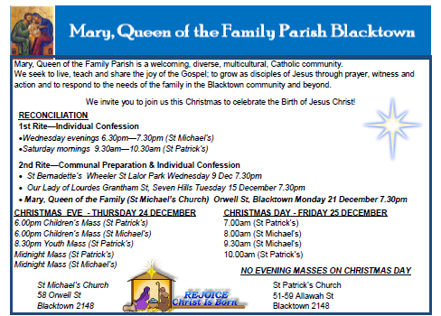
Please take home your Parish Bulletin!

Slide 36
How will I prepare a way for the Lord
this Advent?

